Slide 1

EFS Elastic File System
HackTricks Training
https://t.me/CyberFreeCourses

Slide 2
Basic Information - EFS
Amazon Elastic File System (EFS) is a fully managed, scalable, and elastic network file system by AWS. It allows creating and configuring file systems shared across multiple EC2 instances and other AWS services. EFS automatically scales, provides low-latency access, supports high-throughput workloads, ensures data durability, and integrates with AWS security features.
https://t.me/CyberFreeCourses
https://cloud.hacktricks.xyz/pentesting-cloud/aws-security/aws-services/aws-efs-enum

Slide 3
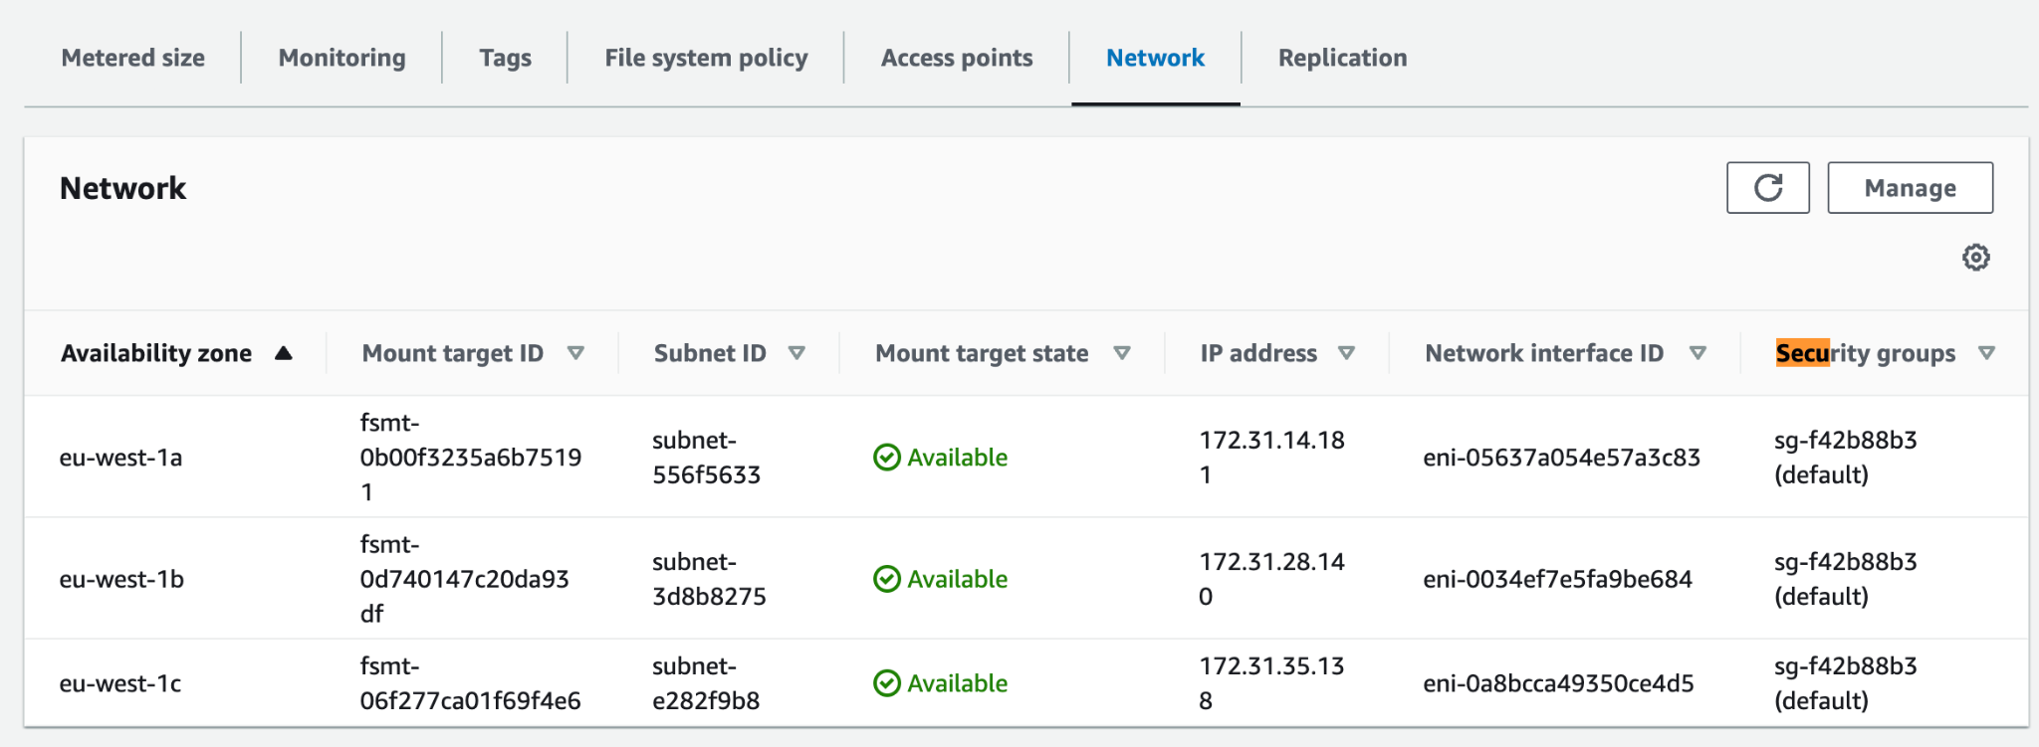
EFS Security Group
An EFS is created in a VPC and would be by default accessible in all the VPC subnetworks. Moreover, the EFS will have a Security Group. In order to give access to an EC2 (or any other AWS service) to mount the EFS, it’s needed to allow in the EFS security group an inbound NFS rule.
https://t.me/CyberFreeCourses
https://cloud.hacktricks.xyz/pentesting-cloud/aws-security/aws-services/aws-efs-enum

Slide 4
EFS Mount
If you have access to the EFS Security Group in the NFS port you will be able to mount it in your host:
sudo mkdir /efs
## Mount found
sudo apt install nfs-common
sudo mount -t nfs4 -o nfsvers=4.1,rsize=1048576,wsize=1048576,hard,timeo=600,retrans=2,noresvport <IP>:/ /efs
## Mount with efs type
## You need to have installed the package amazon-efs-utils
sudo mount -t efs <file-system-id/EFS DNS name>:/ /efs/
https://t.me/CyberFreeCourses
https://cloud.hacktricks.xyz/pentesting-cloud/aws-security/aws-services/aws-efs-enum

Slide 5
EFS Resource Policy - IAM Access
By default, anyone with access to the NFS port in the EFS security group will be able to mount it. But this access can be limited with a resource policy that indicates who could access it with IAM permissions. AWS console offers some examples:
https://t.me/CyberFreeCourses
https://cloud.hacktricks.xyz/pentesting-cloud/aws-security/aws-services/aws-efs-enum
Notes:
Demo enforcing read-only access

Slide 6
EFS Resource Policy - IAM Access
Prevent anonymous access (because it’s allowing all “AWS”, AWS creds will be needed):
{
"Version": "2012-10-17",
"Id": "efs-policy-wizard-08f44cb3-d6fc-47a3-8b53-c976a418ddda",
"Statement": [
{
"Sid": "efs-statement-465cc684-02bc-4442-87a0-83d8bb9f6bbb",
"Effect": "Allow",
"Principal": {
"AWS": "*"
},
"Action": [
"elasticfilesystem:ClientRootAccess",
"elasticfilesystem:ClientWrite"
],
"Condition": {
"Bool": {
"elasticfilesystem:AccessedViaMountTarget": "true"
}
}
}
]
}
https://t.me/CyberFreeCourses
https://cloud.hacktricks.xyz/pentesting-cloud/aws-security/aws-services/aws-efs-enum
Notes:
Demo enforcing read-only access

Slide 7
EFS Resource Policy - IAM Access
Enforce read-only access (lack of “elasticfilesystem:ClientWrite” action):
{
"Version": "2012-10-17",
"Id": "efs-policy-wizard-359c77e7-53ce-4c23-9039-00e7ce24b08a",
"Statement": [
{
"Sid": "efs-statement-62997f04-e66e-428b-aa18-06f4575d17b2",
"Effect": "Allow",
"Principal": {
"AWS": "*"
},
"Action": [
"elasticfilesystem:ClientRootAccess",
"elasticfilesystem:ClientMount"
],
"Condition": {
"Bool": {
"elasticfilesystem:AccessedViaMountTarget": "true"
}
}
}
]
}
https://t.me/CyberFreeCourses
https://cloud.hacktricks.xyz/pentesting-cloud/aws-security/aws-services/aws-efs-enum
Notes:
Demo enforcing read-only access

Slide 8
EFS Resource Policy - IAM Access
To mount:
sudo mount -t efs -o tls,iam <file-system-id/EFS DNS name>:/ /efs/
https://t.me/CyberFreeCourses
https://cloud.hacktricks.xyz/pentesting-cloud/aws-security/aws-services/aws-efs-enum
Notes:
Demo enforcing read-only access

Slide 9
EFS Access Points
Access points are application-specific entry points into an EFS file system that make it easier to manage application access to shared datasets.
Access points can be used for the following purposes:
Simplify permissions management: By defining a POSIX user and group for each access point, you can easily manage access permissions for different applications or users without modifying the underlying file system's permissions.
Enforce a root directory: Access points can restrict access to a specific directory within the EFS file system, ensuring that each application or user operates within its designated folder. This helps prevent accidental data exposure or modification.
Easier file system access: Access points can be associated with an AWS Lambda function or an AWS Fargate task, simplifying file system access for serverless and containerized applications.
https://t.me/CyberFreeCourses
https://cloud.hacktricks.xyz/pentesting-cloud/aws-security/aws-services/aws-efs-enum
Notes:
Demo enforcing read-only access

Slide 10
EFS Access Points
When you create an access point, you can specify the owner and POSIX permissions for the files and directories created through the access point. You can also define a custom root directory for the access point, either by specifying an existing directory or by creating a new one with the desired permissions. This allows you to control access to your EFS file system on a per-application or per-user basis, making it easier to manage and secure your shared file data.
https://t.me/CyberFreeCourses
https://cloud.hacktricks.xyz/pentesting-cloud/aws-security/aws-services/aws-efs-enum
Notes:
Demo enforcing read-only access

Slide 11
Manual Enumeration
DEMO
# Get filesystems and access policies (if any)
aws efs describe-file-systems
aws efs describe-file-system-policy --file-system-id <id>
# Get subnetworks and IP addresses where you can find the file system
aws efs describe-mount-targets --file-system-id <id>
aws efs describe-mount-target-security-groups --mount-target-id <id>
# Get other access points
aws efs describe-access-points
# Get replication configurations
aws efs describe-replication-configurations
# Search for NFS in EC2 networks
nmap -Pn -p 2049 --open 10.10.10.0/24
https://t.me/CyberFreeCourses
https://cloud.hacktricks.xyz/pentesting-cloud/aws-security/aws-services/aws-efs-enum
Notes:
aws --profile myadmin --region eu-west-1 efs describe-file-systems
# Regular without policies
https://eu-west-1.console.aws.amazon.com/efs/home?region=eu-west-1#/file-systems/fs-098383bbe2d1c7851?tabId=mounts
aws --profile myadmin --region eu-west-1 efs describe-mount-targets --file-system-id fs-098383bbe2d1c7851
## Try to mount
sudo mount -t nfs4 -o nfsvers=4.1,rsize=1048576,wsize=1048576,hard,timeo=600,retrans=2,noresvport fs-098383bbe2d1c7851.efs.eu-west-1.amazonaws.com:/ /efs
aws --profile myadmin --region eu-west-1 efs describe-mount-target-security-groups --mount-target-id fsmt-09c87690fba8f3675
aws --profile myadmin --region eu-west-1 ec2 describe-security-groups --group-ids "sg-f42b88b3"
## Give permission to SG(sg-f42b88b3) in port 2049 & retry
## From 0 info
sudo nmap -T4 -Pn -p 2049 --open 172.31.2.232/20
sudo mount -t nfs4 -o nfsvers=4.1,rsize=1048576,wsize=1048576,hard,timeo=600,retrans=2,noresvport 172.31.1.57:/ /efs2
#With policy
aws --profile myadmin --region eu-west-1 efs describe-file-system-policy --file-system-id "fs-088a73e8e42bc0f1f"
sudo mount -t nfs4 -o nfsvers=4.1,rsize=1048576,wsize=1048576,hard,timeo=600,retrans=2,noresvport fs-088a73e8e42bc0f1f.efs.eu-west-1.amazonaws.com:/ efs
sudo mount -t efs -o tls fs-088a73e8e42bc0f1f:/ /efs3
sudo mount -t efs -o tls,iam fs-088a73e8e42bc0f1f:/ /efs3
#Mount Access point
aws --profile myadmin --region eu-west-1 efs describe-access-points
https://eu-west-1.console.aws.amazon.com/efs/home?region=eu-west-1#/file-systems/fs-098383bbe2d1c7851?tabId=accessPoints
sudo mount -t efs -o tls,accesspoint=fsap-00f3d3c7b564294f1 fs-098383bbe2d1c7851 /efs4
# Enseñar que si pusisies en .aws/credentials credenciales de otra cuenta no servirian para montar el EFS

Slide 12
Privilege Escalation
elasticfilesystem:DeleteFileSystemPolicy|elasticfilesystem:PutFileSystemPolicy
Get access by giving it or removing a policy that prevents it
elasticfilesystem:ClientMount|(elasticfilesystem:ClientRootAccess)|(elasticfilesystem:ClientWrite)
Be able to mount the EFS (and to write it)
elasticfilesystem:CreateMountTarget
Create a mount target inside a subnetwork where no mount target exists yet
elasticfilesystem:ModifyMountTargetSecurityGroups
Change the security groups over the mount target to allow access to it
https://t.me/CyberFreeCourses
https://cloud.hacktricks.xyz/pentesting-cloud/aws-security/aws-privilege-escalation/aws-efs-privesc

Slide 13
Persistence
Modify Resource Policy / Security Groups
Create Access Point
https://t.me/CyberFreeCourses
https://cloud.hacktricks.xyz/pentesting-cloud/aws-security/aws-persistence/aws-efs-persistence

